Slide 1
Java 7
El futuro de Java
Víctor Leonel Orozco
(Java SE 7: The Platform Evolves)
Guatejug
http://tuxtor.shekalug.org

Slide 2
Licencia
This work is licensed under a Creative Commons Attribution-ShareAlike 3.0 Guatemala License.

Slide 3
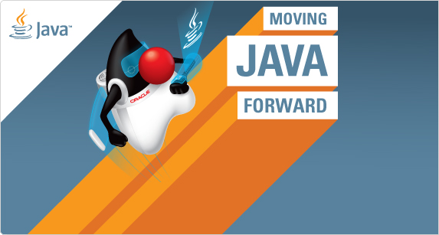
doEvolution(Java. . . versiones)

Slide 4







Java

Slide 5
OpenJDK
JDK7 el segundo de su especie
GPL
Comunidad OpenJDK -> JDK 7
Base para JSR
OpenJDK la plataforma para saltarse JCP y luego entrar a JCP

Slide 6
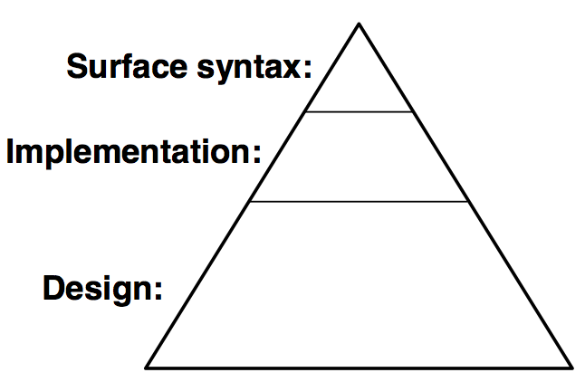
Un largo camino
Actualizar la especificación
Implementar el compilador
Desarrollar nuevas bibliotecas
Pruebas
Actualizar especificaciones JVM
Planear la siguiente evolución
Actualizar las herramientas de la JVM
Actualizar JNI
Actualizar java reflect API
Actualizar serializacion
Verificar compatibilidad

Slide 7
Cambios en JDK 7
Lenguaje (Coin JSR-334)
Lamda, Modularity (8)
DaVinci->Invokedynamic (hi jython you're wellcome!)
NIO 2, Fork/Join(JSR-166y)
Otros (JSR-336)

Slide 8

Coin

Slide 9
Coin
“Pequeños” cambios de lenguaje
  No hay nuevas palabras reservadas
Coordinación con lamda y modularity (8)

Slide 10
La necesidad de evolución
Principios Java
  Lectura es más importante que escritura
  El codigo debe ser agradable a la lectura
  El lenguaje no debe esconder lo que esta pasando
  El codigo debe ejecutar lo que aparenta ejecutar
  La simplicidad importa
“Evolving the Java Language” - JavaOne 2005
Notes:
6/27/11
What is really important to note here is that we are using a slide from JavaOne 2005, this means that from the beginning we have been following the same principles and we are committed to continue to follow these principles as we evolve the language.
- We want the code to be easy to read.
- The language won't hide anything, and it should do what it seems to do
- Even if there are great ideas and features, we are very careful deciding if that feature should be included in the language, some good features add so much weight, it's actually better to leave it out of the language.
Again, we are committed to evolved the language, but very cautiously, we want java to be around for very long time.

Slide 11
Nuevas caracteristicas en numeros
Binary literals
Underrscores
int mask = 0b101010101010;
int mask = 0b1010_1010_1010;
long big = 9_223_783_036_967_937L;
Notes:
6/27/11
Finally we have support for binary literals, and also support for underscores, that allow you to group together, and make it easier to read the literals.

Slide 12
Switch+string (por fin!!!)
Hasta el momento una sentencia switch-case solo funciona con int o enum
Sin embargo no hay motivo para que no funcione con Strings, son un tipo especial de objetos incomutables
Notes:
6/27/11
Before Java SE 7, you can only use integer constants and enum constanst in the case of the switch statement. Now with JDK 7 you can also have String, as they are also constants.

Slide 13
Strings hoy
if(fooString.equalsIgnoreCase("hola")){
System.out.println("hola amigos");
}else if(fooString.equalsIgnoreCase("guatejug")){
System.out.println("guatejug");
}....
}else{
System.out.println("d(ñ_ñ)");
}
Notes:
6/27/11
This is an example pre Java SE 7.
In this code, the monthNameToDays method has two parameters, a string representing a month, and an int for the year. The method will return an int representing the number of days that month has in that particular year.
Because it was not possible to use string in switch statements, we ended up with a bunch of if statements, plus a bunch of comparison for the months, using the method equals from the String class.
Long, ugly and easy to make mistakes!!!!

Slide 14
Strings HOY
switch (fooString) {
case "hola":
System.out.println("hola amigos");
break;
case "guatejug":
System.out.println("guatejug");
break;
…
default:
System.out.println("d(ñ_ñ)");
break;
}
Notes:
6/27/11
This is an example pre Java SE 7.
In this code, the monthNameToDays method has two parameters, a string representing a month, and an int for the year. The method will return an int representing the number of days that month has in that particular year.
Because it was not possible to use string in switch statements, we ended up with a bunch of if statements, plus a bunch of comparison for the months, using the method equals from the String class.
Long, ugly and easy to make mistakes!!!!

Slide 15
Generics
Sin Generics
List strList = new ArrayList();
Notes:
6/27/11
Now, lets have a look at a different topic, Generic. Lets go back in time, before the JDK 5, before we have generics, when we created collections without specifying the type for the elements stored in that collection.

Slide 16
Generics
Sin Generics
List strList = new ArrayList();
Generics hoy
List<String> strList = new ArrayList<String>();
Notes:
6/27/11
Now, lets have a look at a different topic, Generic. Lets go back in time, before the JDK 5, before we have generics, when we created collections without specifying the type for the elements stored in that collection.

Slide 17
Generics
Sin Generics
List strList = new ArrayList();
Generics hoy
List<String> strList = new ArrayList<String>();
Generics hoy
List<Map<String, List<String>> strList =
new ArrayList<Map<String, List<String>>();
Notes:
6/27/11
Now, lets have a look at a different topic, Generic. Lets go back in time, before the JDK 5, before we have generics, when we created collections without specifying the type for the elements stored in that collection.

Slide 18
Generics
Generics HOY (diamond)
List<String> strList = new ArrayList<>();
List<Map<String, List<String>> strList =
new ArrayList<>();

Slide 19
Administración recursos
BufferedReader br;
try{
br = new BufferedReader(
new FileReader("./prueba.txt"));
String line;
while ((line = br.readLine()) != null) {
System.out.println(line);
}
br.close();
} catch (final IOException e) {
System.out.println(e.toString());
} finally{
}

Slide 20
Administración recursos
BufferedReader br;
try{
br = new BufferedReader(
new FileReader("./prueba.txt"));
String line;
while ((line = br.readLine()) != null) {
System.out.println(line);//Puede fallar aca
}
br.close(); //Y ya no llegar aca
System.out.println(":(");
} catch (final IOException e) {
System.out.println(e.toString());
} finally{
}

Slide 21
Administración recursos
try (final BufferedReader br = new BufferedReader(new FileReader("./prueba.txt"))) {
String line;
while ((line = br.readLine()) != null) {
System.out.println(line);
}
} catch (final IOException e) {
System.out.println(e.toString());
}

Slide 22
Multi-catch
try {
if (a == 0) {
throw new ExcepcionA();
}
if (a > 0) {
throw new ExcepcionB();
}
} catch (ExcepcionA ex) {
System.out.println(ex.getClass()
+ " fue lanzada");
} catch (ExcepcionB ex) {
System.out.println(ex.getClass()
+ " fue lanzada");
}

Slide 23
Multi-catch
try {
if (a == 0) {
throw new ExcepcionA();
}
if (a > 0) {
throw new ExcepcionB();
}
} catch (ExcepcionA|ExcepcionB ex) {
System.out.println(ex.getClass() +
" fue lanzada");
}

Slide 24
Más
Heap pollution
Mejores advertencias al utilizar vararg (String. . . foo)
Mejores backtraces

Slide 25
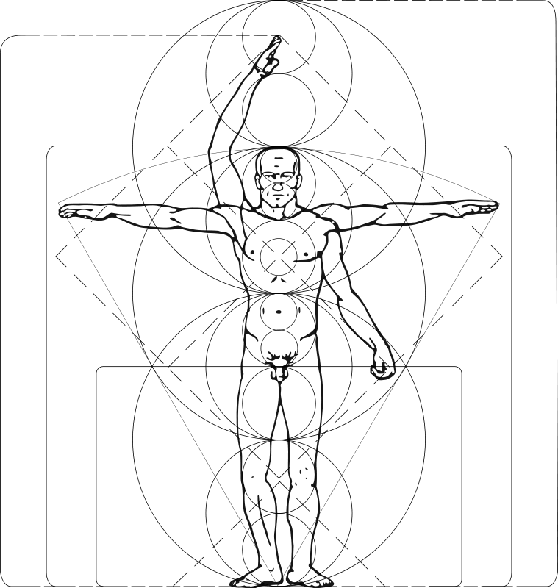
DaVinci->Invokedynamic

Slide 26
JVM una obra de ingeniería
JVM proporciona
  Administración de memoria
  Control de concurrencia
  Seguridad
  Bibliotecas estandar
  Entorno de ejecución premium (rapido y furioso)
  Sesiones de debug

Slide 27
La magia del bytecode
Según las especificaciones de creación de maquinas virtuales la maquina virtual NO RECONOCE NADA acerca de Java, toda su ejecución la hace a través de bytecode.
Java fue solo el principio la comunidad hizo el resto

Slide 28
¿Alguien dijo .net?

Slide 29

Lenguajes
Tea
Zigzag
JESS
Jickle
iScript
Modula-2
Lisp
JavaScript
CAL
Correlate
Nice
Basic
JudoScript
Groovy
Simkin
Drools
Eiffel
Icon
v-language
Pascal
Prolog
Mini
Luck
Tcl
PLAN
Hojo
Scala
Rexx
JavaFX Script
Funnel
Tiger
Anvil
Yassl
Oberon
FScript
E
Smalltalk
JRuby
Logo
Tiger
JHCR
Ada
G
Clojure
Scheme
Dawn
Phobos
Processing
WebL
Sather
TermWare
Sleep
LLP
Pnuts
BeanShell
Forth
PHP
Bex Script
C#
Jython
Yoix
SALSA
ObjectScript
Piccola
Notes:
6/27/11
As we can see the result is that many people have written compilers that will take all sorts of languages and created compilers for them; you can see functional languages, dynamically typed languages, list based languages and so on.

Slide 30
InvokeDynamic
JVM pensada en Java
Cuatro formas de invocar codigo
  Invokevirtual, invokeinterface, invokestatic, invokespecial
Todas necesitan firma (nombre+parametros)
http://openjdk.java.net/projects/mlvm/
JSR-292
JSR 223: Scripting for the Java Platform JDK 6
Notes:
6/27/11
The biggest issue for dynamically typed languages running on the JVM is performance, specifically of how method calls get made. Since Java was designed with static typing it is possible to resolve methods at compile time and include the reference directly in the code (dynamic class loading might seem like an issue, but the new class is still static in its references). The JVM has four ways to invoke a method; most calls will go through invokevirtual. For interfaces invokeinterface is used, static methods use invokestatic and constructors are called by invokespecial. Since these all required a full method signature compiler writers for dynamically typed languages must resolve the reference every time a method is called in case a type involved in the call has changed.
To make life easier we are including the first new bytecode in the JVM instruction set since it was launched. This is called InvokeDynamic and will not be used by Java (at least not until Java SE 8).
The basic idea is that when a method is first called bootstrap code will resolve the reference and store a method handle in a callsite (effectively a function pointer). Subsequent calls to the method will find there is already a method handle and call the method through the callsite. If a type involved in the method signature changes the compiled code can detect this, resolve the method based on the new signature and store the changed reference in the call site. Therefore the method only needs to be resolved when changes are made not every time the method is called. This is much more efficient.

Slide 31
InvokeDynamic
Nueva forma de invocación de funcionalidades a través de un administrador de metodos
La llamada InvokeDynamic genera un administrador del metodo
Fase 0 – Bootstrap, se genera la referencia al metodo de manera dinámica (primera invocación)
Las siguientes llamadas utilizaran esta referencia

Slide 32
InvokeDynamic
this[method_name](x, y)
invokedynamic
[#bootstrapMethod]
.this_method_name
1. Bootstrap
class LangaugeRuntime {
bootstrapMethod(info) {
...
return new CallSite();
}
2. Se genera puntero
3.Enlace dinamico
CallSite
class AClass {
aMethod(x, y) {
...
}
4. Invoca implementacion del metodo
Method
Handle
Notes:
To help understand this we provide a diagram. To shorten this presentation you may want to remove the details of how invokedynamic works as this does not impact on most developers.

Slide 33

Bibliotecas

Slide 34
GUI
Nimbus Look and Feel
Interacción con las API's de transparencia
JLayer
Nuevas mejoras en rendimiento para renderizado 2D (Swing)
Notes:
6/27/11
Java SE 7 als includes some updates to the client libraries.

Slide 35
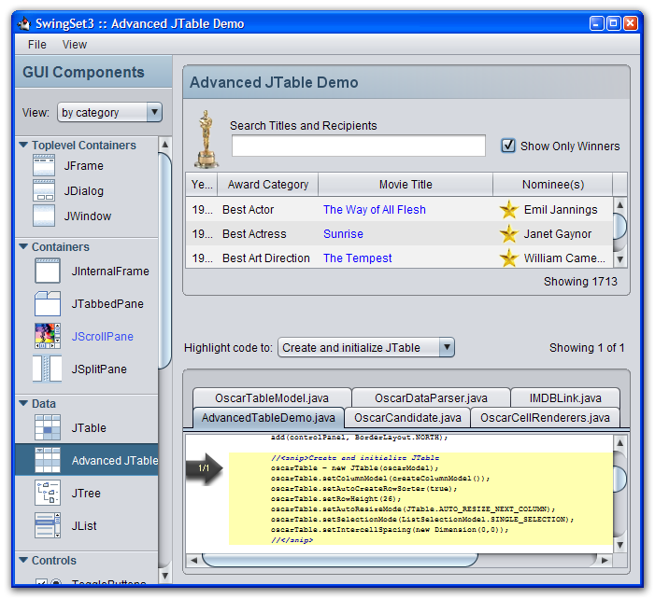
Nimbus Look and Feel
Los dias de metal estan contados
Java SE 6u10, ahora Swing
Notes:
6/27/11
The Nimbus look and feel was introduced in Java SE 6 update 10 as a replacement for the metal cross platform L&F. In Java SE 7 this has been moved to a standard part of the platform (previously it was an oracle extension package, now it is in the javax.swing.plaf package). The decision was made not to make this the default L&F, this will continue to be Metal. Although many people in the community wanted this it was decided that the impact on existing applications would be too great.

Slide 36
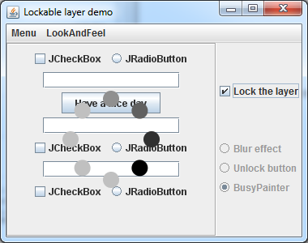
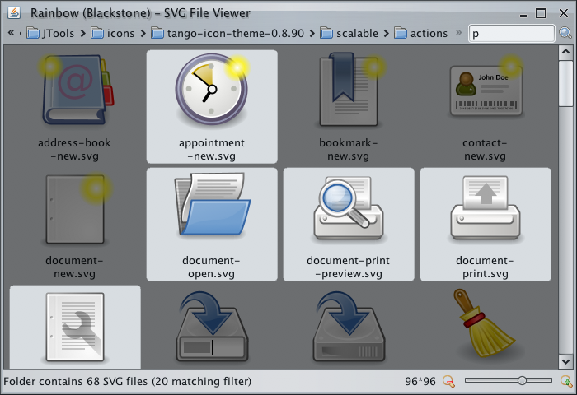
JLayer
Notes:
6/27/11
The Jlayer component provides an easy way to add an overlay to existing Swing components. Examples are a progress wheel or highlighting only vallid choices in a multiple-choice component.

Slide 37
NIO2-JSR 203
La reinvención de las bibliotecas I/O
  No fueron diseñadas para ser extensibles
  Las excepciones tiene problemas y no funcionan como se espera
  rename()funciona parcialmente
  Los desarrolladores necesitan acceso a más datos sin utilizar JNI
NIO2 al rescate

Slide 38
NIO2 :)
Path vrs. File
  File era una clase muy *nix
Mejor soporte a directorios
  list() ahora se comporta como stream via iterator
Soporte de symlinks (hell yeah! )
java.nio.file.Filesystem
  Interfaz a sistemas de archivos (FAT, ZFS, Zip archive, red)
java.nio.file.attribute
  Metadata

Slide 39
Path
Inmutable
Nuevos metodos para Path
Unicamente se puede crear por Path y FileSystem
//Genero la referencia
Path home = Paths.get(“/home/fred”);
//Ingreso a un directorio /home/fred -> /home/fred/tmp
Path tmpPath = home.resolve(“tmp”);
//Convirtiendo a file
File file = relativePath.toFile();
Notes:
Although the Path class is a replacement for the File class there are some differences worth noting. Since Path is an interface it cannot be instantiated directly (unlike File which is a class). The Paths class provides a set of factory methods for creating Path objects, but there are also ways to create a Path from another Path. This is logical because a hierarchical filesystem allows a path to be created between two files in a relative way (frequently using .. To indicate moving to the parent).
Path supports both absolute paths, i.e. how to access the file from the root of the filesystem and relative paths, i.e. how to access the file relative to the current directory.

Slide 40
Concurrencia
JSR166y
Mejor conocido como en framework fork/join
Apis extra para el control de concurrencia
Notes:
6/27/11
Java SE 7 includes updates to the concurrency APIs first introduced in Java SE 5. This is an update to an update;the orinial utilities were defined in JSR166. This was eXtended in JSR166x (Java SE 6) and extended further through JSR166y (Java SE 7).
Introduces the fork-join framework for fine grained parallelism
The Phaser which is a reusable synchronization barrier, similar in functionality to CyclicBarrier and CountDownLatch but supporting more flexible usage.
A TransferQueue is a BlockingQueue in which producers may wait for consumers to receive elements. A TransferQueue may be useful for example in message passing applications in which producers sometimes (using method transfer(E)) await receipt of elements by consumers invoking take or poll, while at other times enqueue elements (via method put) without waiting for receipt. Non-blocking and time-out versions of tryTransfer are also available. A TransferQueue may also be queried, via hasWaitingConsumer(), whether there are any threads waiting for items, which is a converse analogy to a peek operation. Like other blocking queues, a TransferQueue may be capacity bounded. If so, an attempted transfer operation may initially block waiting for available space, and/or subsequently block waiting for reception by a consumer. Note that in a queue with zero capacity, such as SynchronousQueue, put and transfer are effectively synonymous. This is implemented by the LinkedTransferQuue which is an unbounded TransferQueue based on linked nodes. This queue orders elements FIFO (first-in-first-out) with respect to any given producer. The head of the queue is that element that has been on the queue the longest time for some producer. The tail of the queue is that element that has been on the queue the shortest time for some producer.

Slide 41
Fork Join
Tomar ventajas de multiples procesadores
Solo se puede tomar ventaja si la operacion puede dividirse en varias partes
  fib(10) = fib(9) + fib(8)
Si la tarea es posible
ejecutar la tarea
si no es posible
dividir la tarea en tareas pequeñas similares (fork)
unir los resultados (join)
Notes:
The fork-join framework is designed for fine grained tasks where a large task can easily be broken up into a large number of sub-tasks. This is best suited to sub-tasks that do not rely on shared, mutatable data. The framework will work well with shared, read-omly data, but if multiple subtasks are trying to modify shared data the issues of locking and contention reduce the frameworks overall efficiency.

Slide 42



Java 8
Project Jigsaw (JSR-294)
Modularizacion (nivel superior a paquetes)
Project Lambda (JSR 335)
Closures
Mejor soporte a procesadores multicore
Coin
Más coins
Notes:
6/27/11
Here’s a very quick look at the major features being proposed for Java SE 8
Project Jigsaw will bring true modularity to the Java platform and applications. The idea is to move away from jar files and their limitations and support things like versioning and simplified inter-dependency definitions.
Project Lambda will bring closure-like support to Java in the form of lambda expressions. This is a replacement for single abstract method classes which are used frequently in Java and anonymous inner classes. This will also build on the fork-join framework to provide ParallelArray functionality to enhance support for multi-processor/core machines.
There will also be more small language changes in the form of an extension to project Coin. There are no details of what these changes will be at this time.

Slide 43

Gracias
http://www.guate-jug.org
http://tuxtor.shekalug.org
tuxtor@shekalug.org
http://www.slideshare.com/tuxtor
http://tuxtor.shekalug.org/talks
Notes:
6/27/11
To conclude we can see that Java SE 7 is an incremental change over Java SE 6 providing evolutionary, not revolutionary new features. The changes that are included provide a good, solid set of enhancements to make developers lives easier whilst not affecting backwards compatability. Support for things like the fork-join framework will enable applications to benefot from developments in hardware without having to write complex code.
Java SE 8 which we only covered very briefly will introduce more substantial features that will help Java developers to be even more productive.
The important thing to get from this presentation is that Java is not “the new Cobol”. It is adapting to the needs of developers and new types of applications and platforms.

